Slide 1
CAP6135: Malware and Software Vulnerability Analysis
Software Security Introduction
Cliff Zou
Spring 2012

Slide 2
Acknowledgement
This lecture is extended and modified from lecture notes by Dr. Erik Poll
  Spring’08 course: software security

Slide 3
Overview
What is software security ?
  Understanding the role that software plays
    in providing security
    as source of insecurity
Principles, methods & technologies to make software more secure
  Practical experience with some of these
Typical threats & vulnerabilities in software, and how to avoid them

Slide 4
Overview
Software plays a major role in providing security, and is a major source of security problems
Software security does not get much attention
  In programming courses
    Many future programmers have little training on software security
  In software company’s goal

Slide 5
Overview
We focus on software security, but don’t forget that security is about many things:
  people
    human computer interaction, HCI
    Attackers, users, employees, sys-admins, programmers
  access control, passwords, biometrics
  cryptology, protocols
  Monitoring, auditing, risk management
  Policy, legislation
  public relations, public perception
  ….

Slide 6
Security Concepts and Goals

Slide 7
Software and Security
Security is about regulating access to assets
  E.g., information or functionality
Software provides functionality
  E.g., on-line exam results
This functionality comes with certain risks
  E.g., what are risks of on-line exam results?
    Privacy (score leakage); Modification
Software security is about managing these risks

Slide 8
Software and Security
Security is always a secondary concern
  Primary goal of software is to provide functionalities or services
  Managing associated risks is a derived/secondary concern
There is often a trade-off/conflict between
  security
  functionality & convenience
Security achievement is hard to evaluate when nothing bad happens

Slide 9
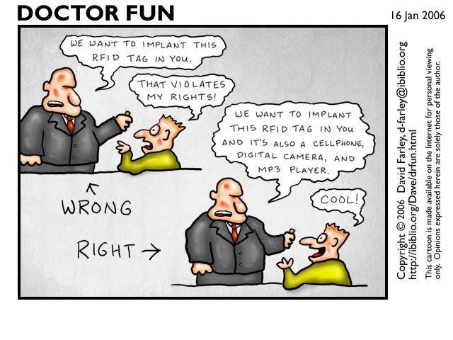
Functionality vs Security

Slide 10
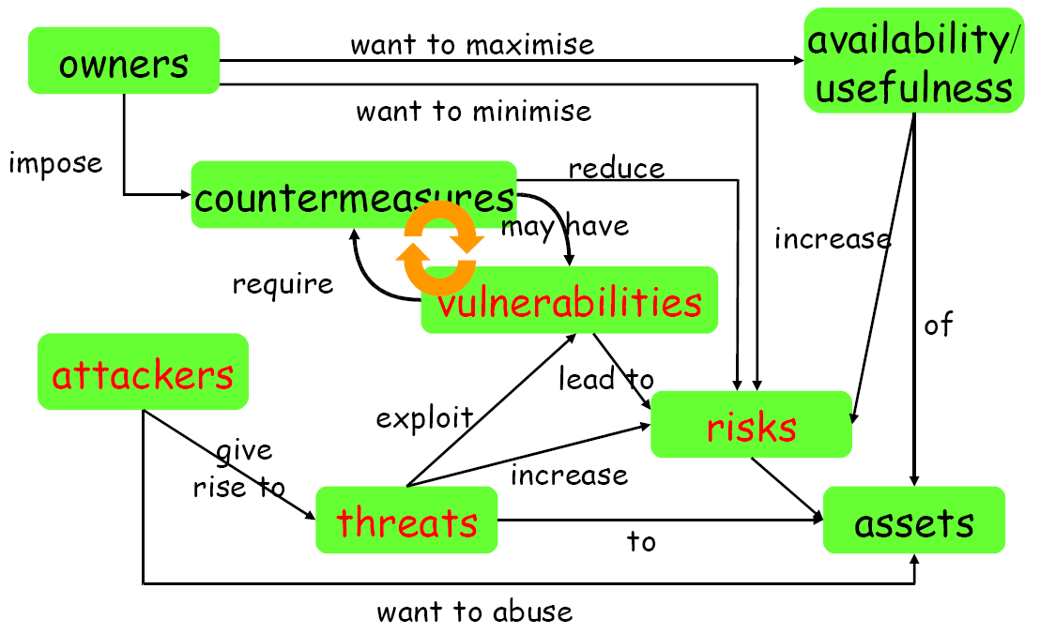
Security Concept

Slide 11
Starting Point for Ensuring Security
Any discussion of security should start with an inventory of
  the stakeholders (owners, companies…)
  their assets (data, service, customer info…)
  the threats to these assets (erase, steal…)
  Attackers
    employees, clients, script kiddies, criminals
Any discussion of security without understanding these issues is meaningless

Slide 12
Security Concepts
Security is about imposing countermeasures to reduce risks to assets to acceptable levels
  “Perfect security” is not necessary and costly
A security policy is a specification of what security requirements/goals the countermeasures are intended to achieve
  secure against what and from whom ?
Security mechanisms to enforce the policy
  What actions we should take under an attack?

Slide 13
Security Objectives: CIA
Confidentiality (or secrecy)
  unauthorized users cannot read information
Integrity
  unauthorized users cannot alter information
Availability
  authorized users can always access information
Non-repudiation for accountability
  authorized users cannot deny actions
Others
  Privacy, anonymity…

Slide 14
Security Goals
The well-known trio
  confidentiality, integrity, avaliability (CIA)
There are more “concrete” goals
  traceability and auditing (forensics)
  monitoring (real-time auditing)
  multi-level security
  privacy & anonymity
  ...
and meta-property
  assurance – that the goals are met
    “information assurance”

Slide 15
How to Realize Security Objectives? AAAA
Authentication
  who are you?
Access control/Authorization
  control who is allowed to do what
  this requires a specification of who is allowed to do what
Auditing
  check if anything went wrong
Action
  if so, take action

Slide 16
How to Realize Security Objectives?
Other names for the last three A's
  Prevention
    measures to stop breaches of security goals
  Detection
    measures to detect breaches of security goals
  Reaction
    measures to recover assets, repair damage, and persecute (and deter) offenders
Good prevention does not make detection & reaction superfluous
  E.g., breaking into any house with windows is trivial; despite this absence of prevention, detection & reaction still deter burglars

Slide 17
Threats vs Security Requirements
information disclosure
  confidentiality
tampering with information
  integrity
denial-of-service (DoS)
  availability
spoofing
  authentication
unauthorized access
  access control

Slide 18
Countermeasures
Countermeasures can be non-IT related
  physical security of building
  screening of personnel
  legal framework to deter criminals
  training employee
but we won’t consider these

Slide 19
Countermeasures and More Vulnerabilities
Countermeasures can lead to new vulnerabilities
  E.g., if we only allow three incorrect logins, as a countermeasure to brute-force attacks (account be frozen), which new vulnerability do we introduce?
    Denial of Service attack
  If a countermeasure relies on new software, bugs in this new software may mean
    that it is ineffective, or
    worse still, that it introduces more weaknesses
    E.g., Witty worm appeared in Mar 2004 exploited ISS security software
      http://en.wikipedia.org/wiki/Witty_%28computer_worm%29

Slide 20
Example: insecurities in SSH
From www.cert.org/advisories for (Open)SSH
  CA-2001-35 Recent Activity Against Secure Shell Daemon (Dec 13)
    Multiple vulnerabilities in several implementations of SSH. ...
  CA-2002-18 OpenSSH Vulnerability in challenge-response handling (Jun 26)
    Vulnerabilities in challenge response handling code ...
  CA-2002-23 Multiple Vulnerabilities in OpenSSH (July 30)
    Four remotely exploitable buffer overflows in ...
  CA-2002-24 Trojan Horse OpenSSH Distribution (Aug 1)
    Some copies of the source code of OpenSSH package contain a Trojan horse.
  CA-2002-36 Multiple Vulnerabilities in SSH Implementations (Dec 16)
    Multiple vendors' implementations of SSH contain vulnerabilities...
  CA-2003-24: Buffer Management Vulnerability in OpenSSH (Sept 16)
    There is a remotely exploitable buffer overflow in versions of OpenSSH prior to 3.7. ...

Slide 21
Example: insecurities in SSH
SSH was meant to provide security, namely as countermeasure against eavesdropping on network, but is a source of new vulnerabilities
Crypto is not the cause of these vulnerabilities, and could not solve/prevent these vulnerabilities
  Protocol, implementation errors (e.g., WEP in WiFi)
  Programming errors (buffer overflow)
  Distribution errors (trojan)
Bruce Schneier: “Currently encryption is the strongest link we have. Everything else is worse: software, networks, people. There's absolutely no value in taking the strongest link and making it even stronger”

Slide 22
Software Security

Slide 23
Two Sides to Software Security
What are the methods and technologies, available to us if we want to provide security?
  security in the software development lifecycle
  engineering & design principles
  security technologies
What are the methods and technologies available to the enemy who wants to break security ?
  What are the threats and vulnerabilities we’re up against?
  What are the resources and tools available to attackers?

Slide 24
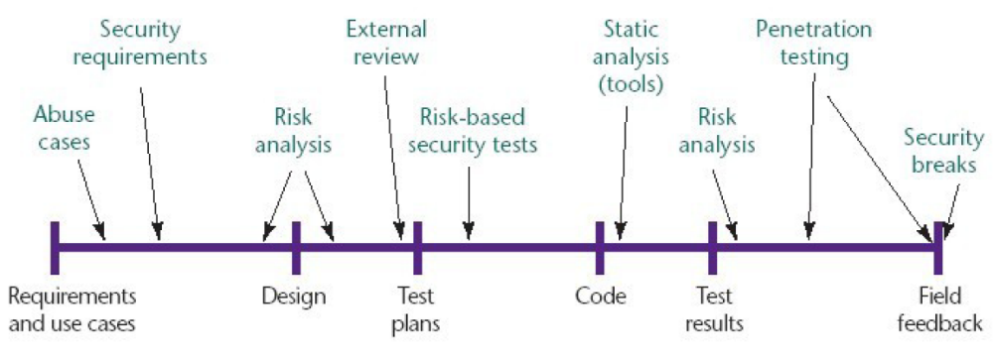
Security in Software Development Life Cycle
Source: Gary McGraw, Software security, Security & Privacy Magazine, IEEE, Vol 2, No. 2, pp. 80-83, 2004.

Slide 25
Example Security Technologies
Cryptography
  for threats related to insecure communication and storage
  Covered in other courses
Access control
  for threats related to misbehaving users
  E.g., role-based access control
Language-based security
  for threats related to misbehaving programs
    typing, memory-safety
    sandboxing
  E.g., Java, .NET/C#

Slide 26
Example Security Technologies
These technologies may be provided by the infrastructure/platform an application builds on,
  networking infrastructure
    which may e.g. use SSL
  operating system or database system
    providing e.g. access control
  programming platform
    for instance Java or .NET sandboxing
Of course, software in such infrastructures implementing security has to be secure

Slide 27
Software Infrastructure
Applications are built on top of "infrastructure" consisting of
  operating system
  programming language/platform/middleware
    programming language itself
      interface to CPU & RAM
    libraries and APIs
      interface to peripherals (socket, interrupt…)
      provider of building blocks
  other applications & utilities
    E.g., database
This infrastructure provides security mechanisms, but is also a source of insecurity

Slide 28
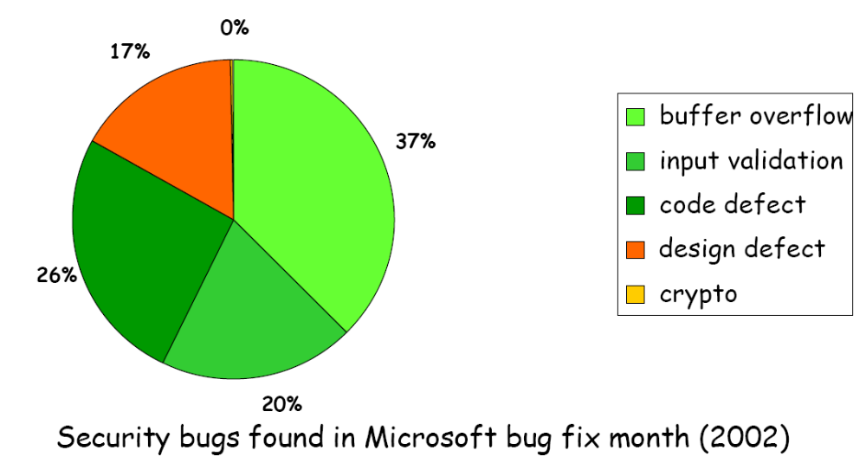
Typical Software Security Vulnerabilities

Slide 29
Sources of Software Vulnerabilities
Bugs in the application or its infrastructure
  i.e. doesn't do what it should do
    E.g., access flag can be modified by user input
Inappropriate features in the infrastructure
  i.e. does something that it shouldn't do
    functionality winning over security
    E.g., a search function that can display other users info
Inappropriate use of features provided by the infrastructure
Main causes:
  complexity of these features
    functionality winning over security, again
  ignorance of developers

Slide 30
Functionality vs Security
Lost battles?
operating systems
  huge OS, with huge attack surface (API),
programming languages
  buffer overflows, format strings, ... in C
  public fields in Java
  lots of things in PHP
webbrowsers
  plug-ins for various formats, javascript, VBscript, ...
email clients

Slide 31
Threat Modeling

Slide 32
Threat Modeling
Aka security/risk/requirements analysis
A first step, not just for software
  Identify assets & stakeholders
  Consider architecture of application & its environment
  Brainstorm about known threats
  Define security assumptions
  Rank threats by risk
    ≈ impact x likelihood
  Decide which threats to respond to
  Decide how to mitigate these threats
    which techniques & technologies

Slide 33
Example Techniques to Mitigate Threats
Spoofing Identity
  authentication, protect keys & passwords, ...
Tampering with Data
  access control, hashes, digital signatures, MACs (message authentication codes), write-once storage...
Repudiation
  logging, audit trails, digital signatures, ...
Information Disclosure
  access control, encryption, not storing secrets, ...
Denial of Service
  graceful degradation, filtering, increase server resources
Elevation of Privilege
  access control, sandboxing, ...

Slide 34
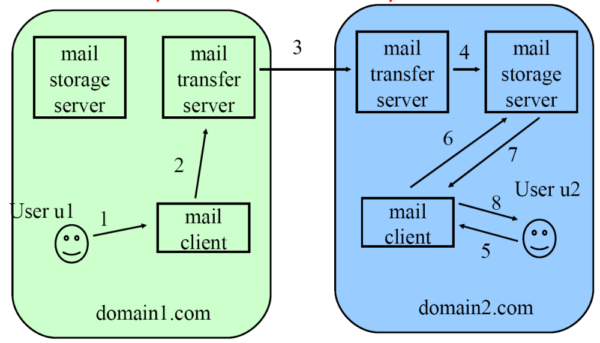
Example: Email System

Slide 35
Potential threats to the e-mail system
Eavesdropping on e-mail
  Communication over the Internet is relatively easy to eavesdrop
  Hence, content of e-mail is by no means confidential
  Critical information can be encrypted and in email attachment
Modifying e-mail
  Interception of the communication (e.g. between the two MTS’s) allows an attacker to modify the e-mail
  Hence, integrity of the e-mail is not guaranteed
Spoofing e-mail
  MTS blindly believes other MTS about who the sender of the e-mail is
  Hence, no guarantee about the identity of the sender
Attacks against the mail servers
  Server is a “trusted software layer”, making a limited functionality (sending/receiving mail) available to all clients
Email as an attack dispersion channel

Slide 36
Attack Formats
Spam
  Marketer can send massive amounts of unsolicited e-mail
Denial-of-service attacks
  Amount of storage space on mail server can be exhausted by receiving too many very big e-mails
  A mail server is slowed down by too many received emails
  A client receives thousands of garbage emails and hence missing real email
Phishing
  Email clients trust received spoofed email
  Give out their private data (e.g., back account) accordingly
    Direct reply back
    Input in a directed fake website
Email malware
  E-mail client is again a trusted software layer
  Executable attachments make virus-spreading easy

Slide 37
Possible Defenses
Many other threats
  Privacy threat: detecting when an e-mail is read
  Repudiation of sending: sender can deny having sent a message
  Repudiation of receiving: receiver can deny having ever received a particular message
Eavesdropping and modification
  Can be countered by cryptographic techniques
Spoofing
  Can be countered by strong authentication protocols
Attacks against servers
  Can be countered by
    Careful software coding
    Clear access control model
    Strong authentication
However, email spam, phishing are hard to defend
  Phishing: there are always users without security knowledge!

Slide 38
Vulnerabilities in Countermeasures
Each of the discussed countermeasures can again have vulnerabilities:
  Bad choice of cryptographic algorithm
  Protocol design weakness
  Implementation bug
  …
  Example: Witty worm in 2004
    Compromise a class of security software from Internet Security Systems (ISS) now IBM Internet Security Systems installed on user computers
    http://en.wikipedia.org/wiki/Witty_%28computer_worm%29

